Slide 1
AI Website
Version 2

Slide 2


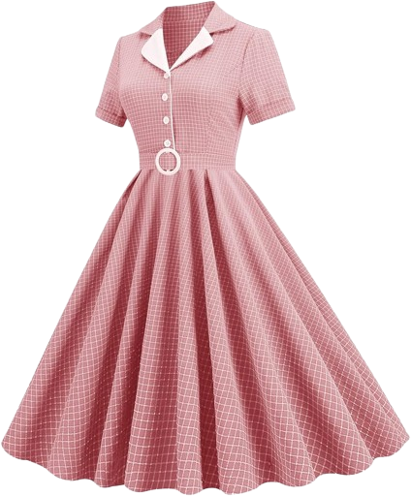
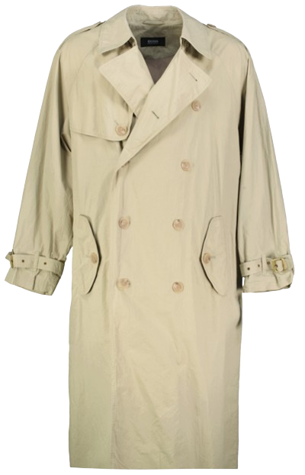



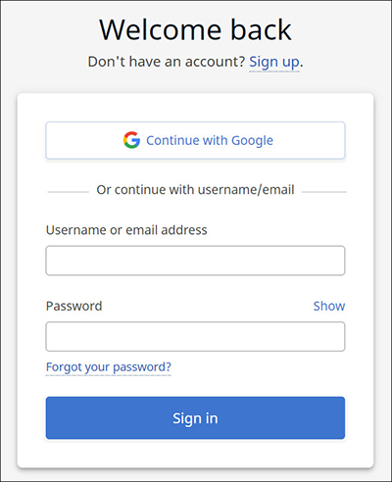
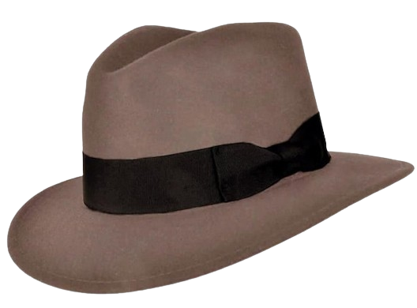
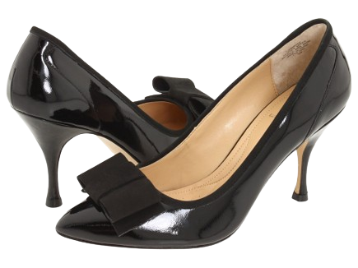
Notes:
This

Slide 3

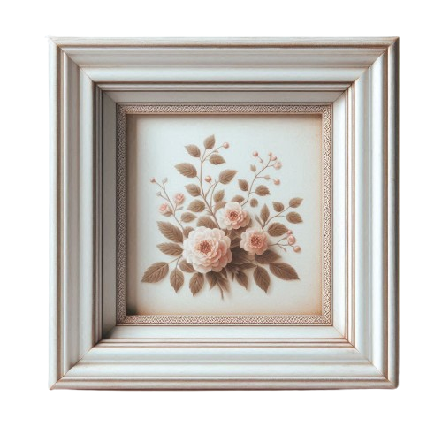


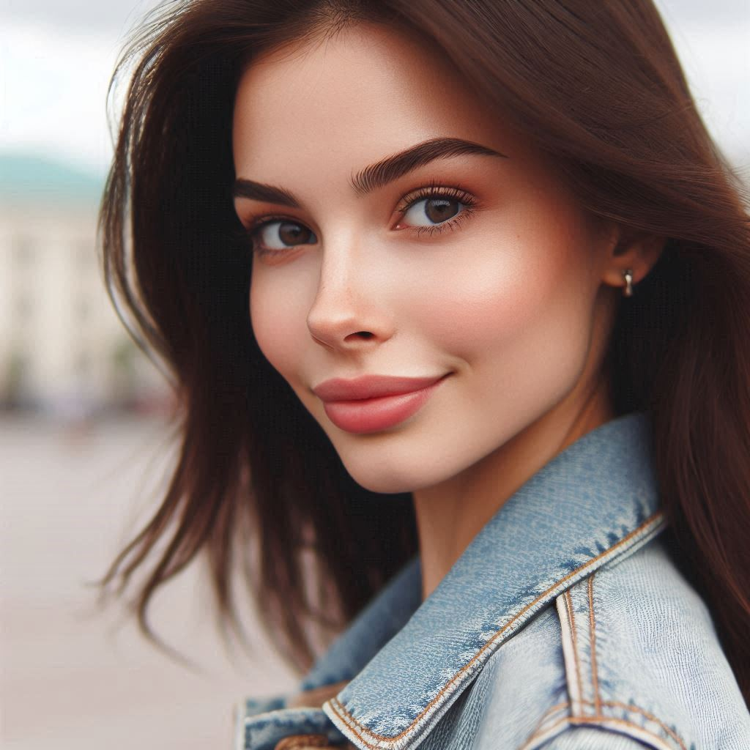
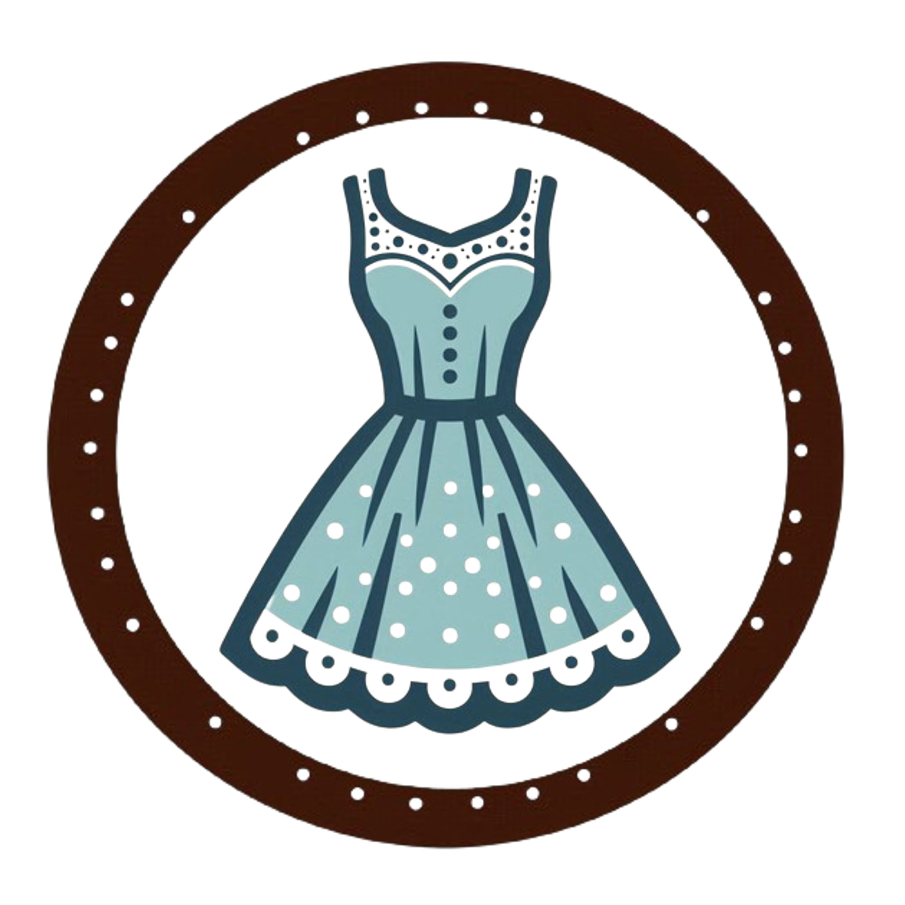


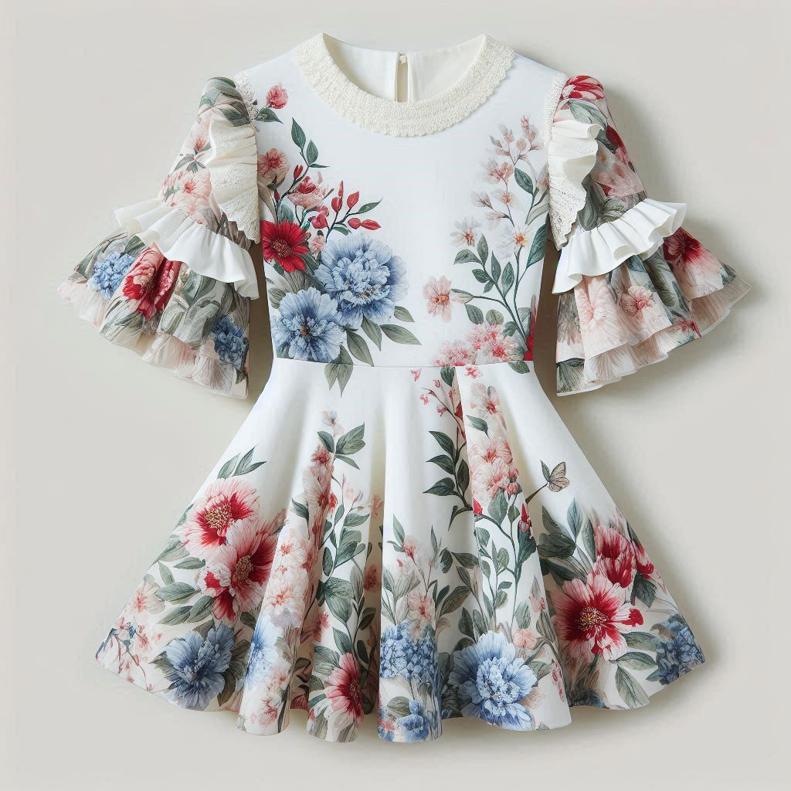
















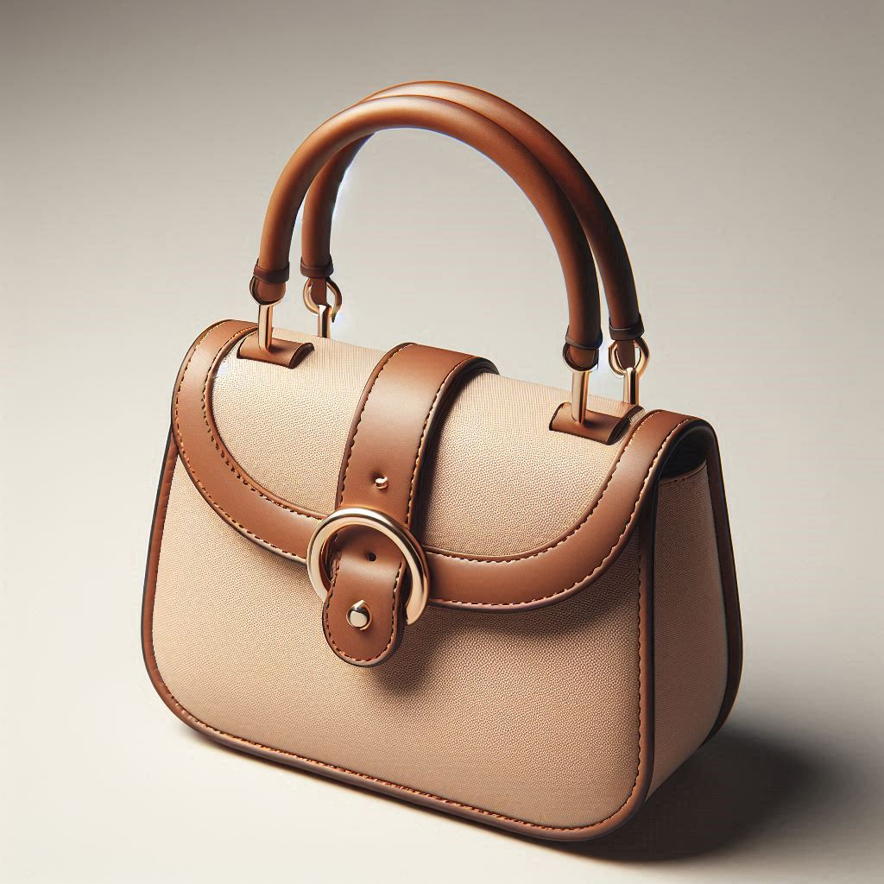

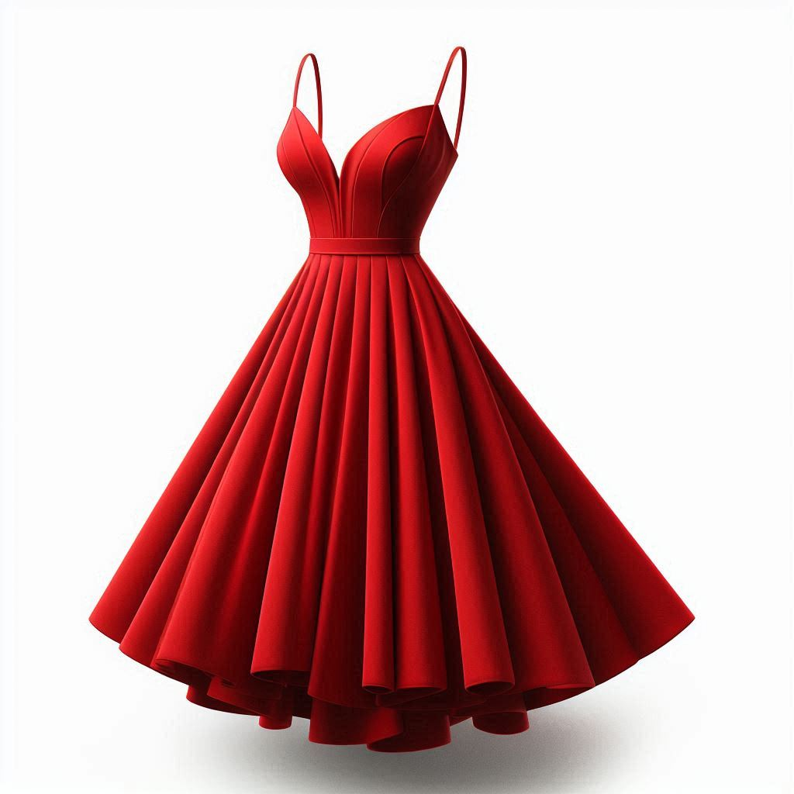
I’m looking for… some shoes for a night out
Personal Fit
Featured Feeds
Most Wishlisted
Laurie
Home
Top Brands
Clothing Items
Wishlist & History
Great Deals
Shopping Cart
Spring Vogue
Sell your Items
80% OFF + 18 MSI
HOT SALE ALERT !
About us
© 2024 VINTAGE VOGUE
Our locations
White floral dress by Zara with decorative bl
UP TO
More…
50
*Conditions apply
Small and elegant purse by Dasein with metal
More…
17
White floral dress by Zara with decorative bl
More…
71
Notes:
This is a mockup of what the final design would look like.

Slide 4

I’m looking for… some shoes for a night out
Personal Fit
Please fill in your Personal Sizing Information in your User Settings
Featured Feeds
Most Wishlisted
Laurie
Home
Top Brands
Clothing Items
Wishlist & History
Great Deals
Shopping Cart
Spring Vogue
Sell your Items
80% OFF + 18 MSI
HOT SALE ALERT !
About us
© 2024 VINTAGE VOGUE
Our locations
White floral dress by Zara with decorative bl
UP TO
More…
50
*Conditions apply
Small and elegant purse by Dasein with metal
More…
17
White floral dress by Zara with decorative bl
More…
71
Notes:
One of the first features for this website is the implementation of a “Personal Fit” filter. This allows for the user’s main feed to be pre-filtered only with items that fit their size.
It must be specified in the user settings, which is available by clicking the profile picture. It is best that even though the user hasn’t yet filled in the information to the

Slide 5
I’m looking for… some shoes for a night out
Personal Fit
Featured Feeds
Most Wishlisted
Laurie
Home
Top Brands
Clothing Items
Wishlist & History
Great Deals
Shopping Cart
Spring Vogue
Sell your Items
80% OFF + 18 MSI
HOT SALE ALERT !
About us
© 2024 VINTAGE VOGUE
Our locations
White floral dress by Zara with decorative bl
UP TO
More…
50
*Conditions apply
Small and elegant purse by Dasein with metal
More…
17
White floral dress by Zara with decorative bl
More…
71
Notes:
One of the first features for this website is the implementation of a “Personal Fit” filter. This allows for the user’s main feed to be pre-filtered only with items that fit their size.
It must be specified in the user settings, which is available by clicking the profile picture. It is best that even though the user hasn’t yet filled in the information to the

Slide 6



I’m looking for… some shoes for a night out
Personal Fit
Featured Feeds
User Information
Most Wishlisted
Hi,
Laurie
Last name
Laurie
email
Phone number
Home
dd/mm/yyyy
Top Brands
Clothing Items
Change account password
Shipping Address
Wishlist & History
Great Deals
Street
External Number
Internal Number
Zip Number
Shopping Cart
State
City
Country
Spring Vogue
Sell your Items
Payment Information
80% OFF + 18 MSI
HOT SALE ALERT !
About us
© 2024 VINTAGE VOGUE
Our locations
UP TO
Personal Sizing Information Sharing this information helps us provide you with personalized recommendations on your feeds. Without it, you'll see a broader range of items that may not be the best fit for you. Take the measurements in centimeters.
*Conditions apply
Men
Women
Head
Head
Chest
Bust
Waist
Hips
Hips
Shoes
Shoes
Notes:
What is shown in this page is a basic user information form. It is not intended to be a final design.

Slide 7
User Information
Hi,
Laurie
Last name
email
Phone number
dd/mm/yyyy
Change account password
Shipping Address
Street
External Number
Internal Number
Zip Number
I’m looking for… some shoes for a night out
State
City
Country
Personal Fit
Featured Feeds
Payment Information
Most Wishlisted
Laurie
Home
Personal Sizing Information Sharing this information helps us provide you with personalized recommendations on your feeds. Without it, you'll see a broader range of items that may not be the best fit for you. Take the measurements in centimeters.
Top Brands
Clothing Items
Wishlist & History
Men
Women
Great Deals
Head
Head
Shopping Cart
Chest
Bust
Spring Vogue
Sell your Items
Waist
Hips
Hips
80% OFF + 18 MSI
HOT SALE ALERT !
About us
© 2024 VINTAGE VOGUE
Shoes
Shoes
Our locations
UP TO
*Conditions apply
Notes:
Solve the Size Issue & Create Size Charts that Reduce Returns and Keep Your Customers Happy. Personal Sizing information will take as reference international dressing sizes as shown in:
https://www.size.ly/conversion-charts/international-dress-size-conversion-chart

Slide 8
I’m looking for… some shoes for a night out
Personal Fit
Featured Feeds
Most Wishlisted
Laurie
Home
Top Brands
Clothing Items
Wishlist & History
Great Deals
Shopping Cart
Spring Vogue
Sell your Items
80% OFF + 18 MSI
HOT SALE ALERT !
About us
© 2024 VINTAGE VOGUE
Our locations
White floral dress by Zara with decorative bl
UP TO
More…
50
*Conditions apply
Small and elegant purse by Dasein with metal
More…
17
White floral dress by Zara with decorative bl
More…
71
Notes:
This is a mockup of what the final design would look like.

Slide 9
White floral dress by Zara with decorative bl
I’m looking for… some shoes for a night out
More…
50
Personal Fit
Featured Feeds
Most Wishlisted
Laurie
Home
Top Brands
Clothing Items
Wishlist & History
Great Deals
Shopping Cart
Spring Vogue
Sell your Items
80% OFF + 18 MSI
HOT SALE ALERT !
About us
© 2024 VINTAGE VOGUE
Our locations
Small and elegant purse by Dasein with metal
UP TO
More…
17
*Conditions apply
White floral dress by Zara with decorative bl
More…
71
Notes:
The customers can immediately notice that they can scroll down the website to look at each of the items

Slide 10
White floral dress by Zara with decorative bl
More…
50
Small and elegant purse by Dasein with metal
I’m looking for… some shoes for a night out
More…
17
Personal Fit
Featured Feeds
Most Wishlisted
Laurie
Home
Top Brands
Clothing Items
Wishlist & History
Great Deals
Shopping Cart
Spring Vogue
Sell your Items
80% OFF + 18 MSI
HOT SALE ALERT !
About us
© 2024 VINTAGE VOGUE
Our locations
White floral dress by Zara with decorative bl
UP TO
More…
71
*Conditions apply
Notes:
This is a mockup of what the final design should look like.

Slide 11
White floral dress by Zara with decorative bl
More…
50
Small and elegant purse by Dasein with metal
I’m looking for… some shoes for a night out
More…
17
Personal Fit
Featured Feeds
Most Wishlisted
Laurie
Home
Top Brands
Clothing Items
Wishlist & History
Great Deals
Shopping Cart
Spring Vogue
Sell your Items
80% OFF + 18 MSI
HOT SALE ALERT !
About us
© 2024 VINTAGE VOGUE
Our locations
White floral dress by Zara with decorative bl
UP TO
More…
71
*Conditions apply
Notes:
This is a mockup of what the final design should look like.

Slide 12
White floral dress by Zara with decorative bl
More…
50
Small and elegant purse by Dasein with metal
I’m looking for… some shoes for a night out
More…
17
Personal Fit
Featured Feeds
Most Wishlisted
Laurie
Home
Top Brands
Clothing Items
Women
Men
Wishlist & History
Great Deals
Shopping Cart
Spring Vogue
Sell your Items
80% OFF + 18 MSI
HOT SALE ALERT !
About us
© 2024 VINTAGE VOGUE
Our locations
White floral dress by Zara with decorative bl
UP TO
More…
71
*Conditions apply
Notes:
This is a mockup of what the final design should look like.

Slide 13
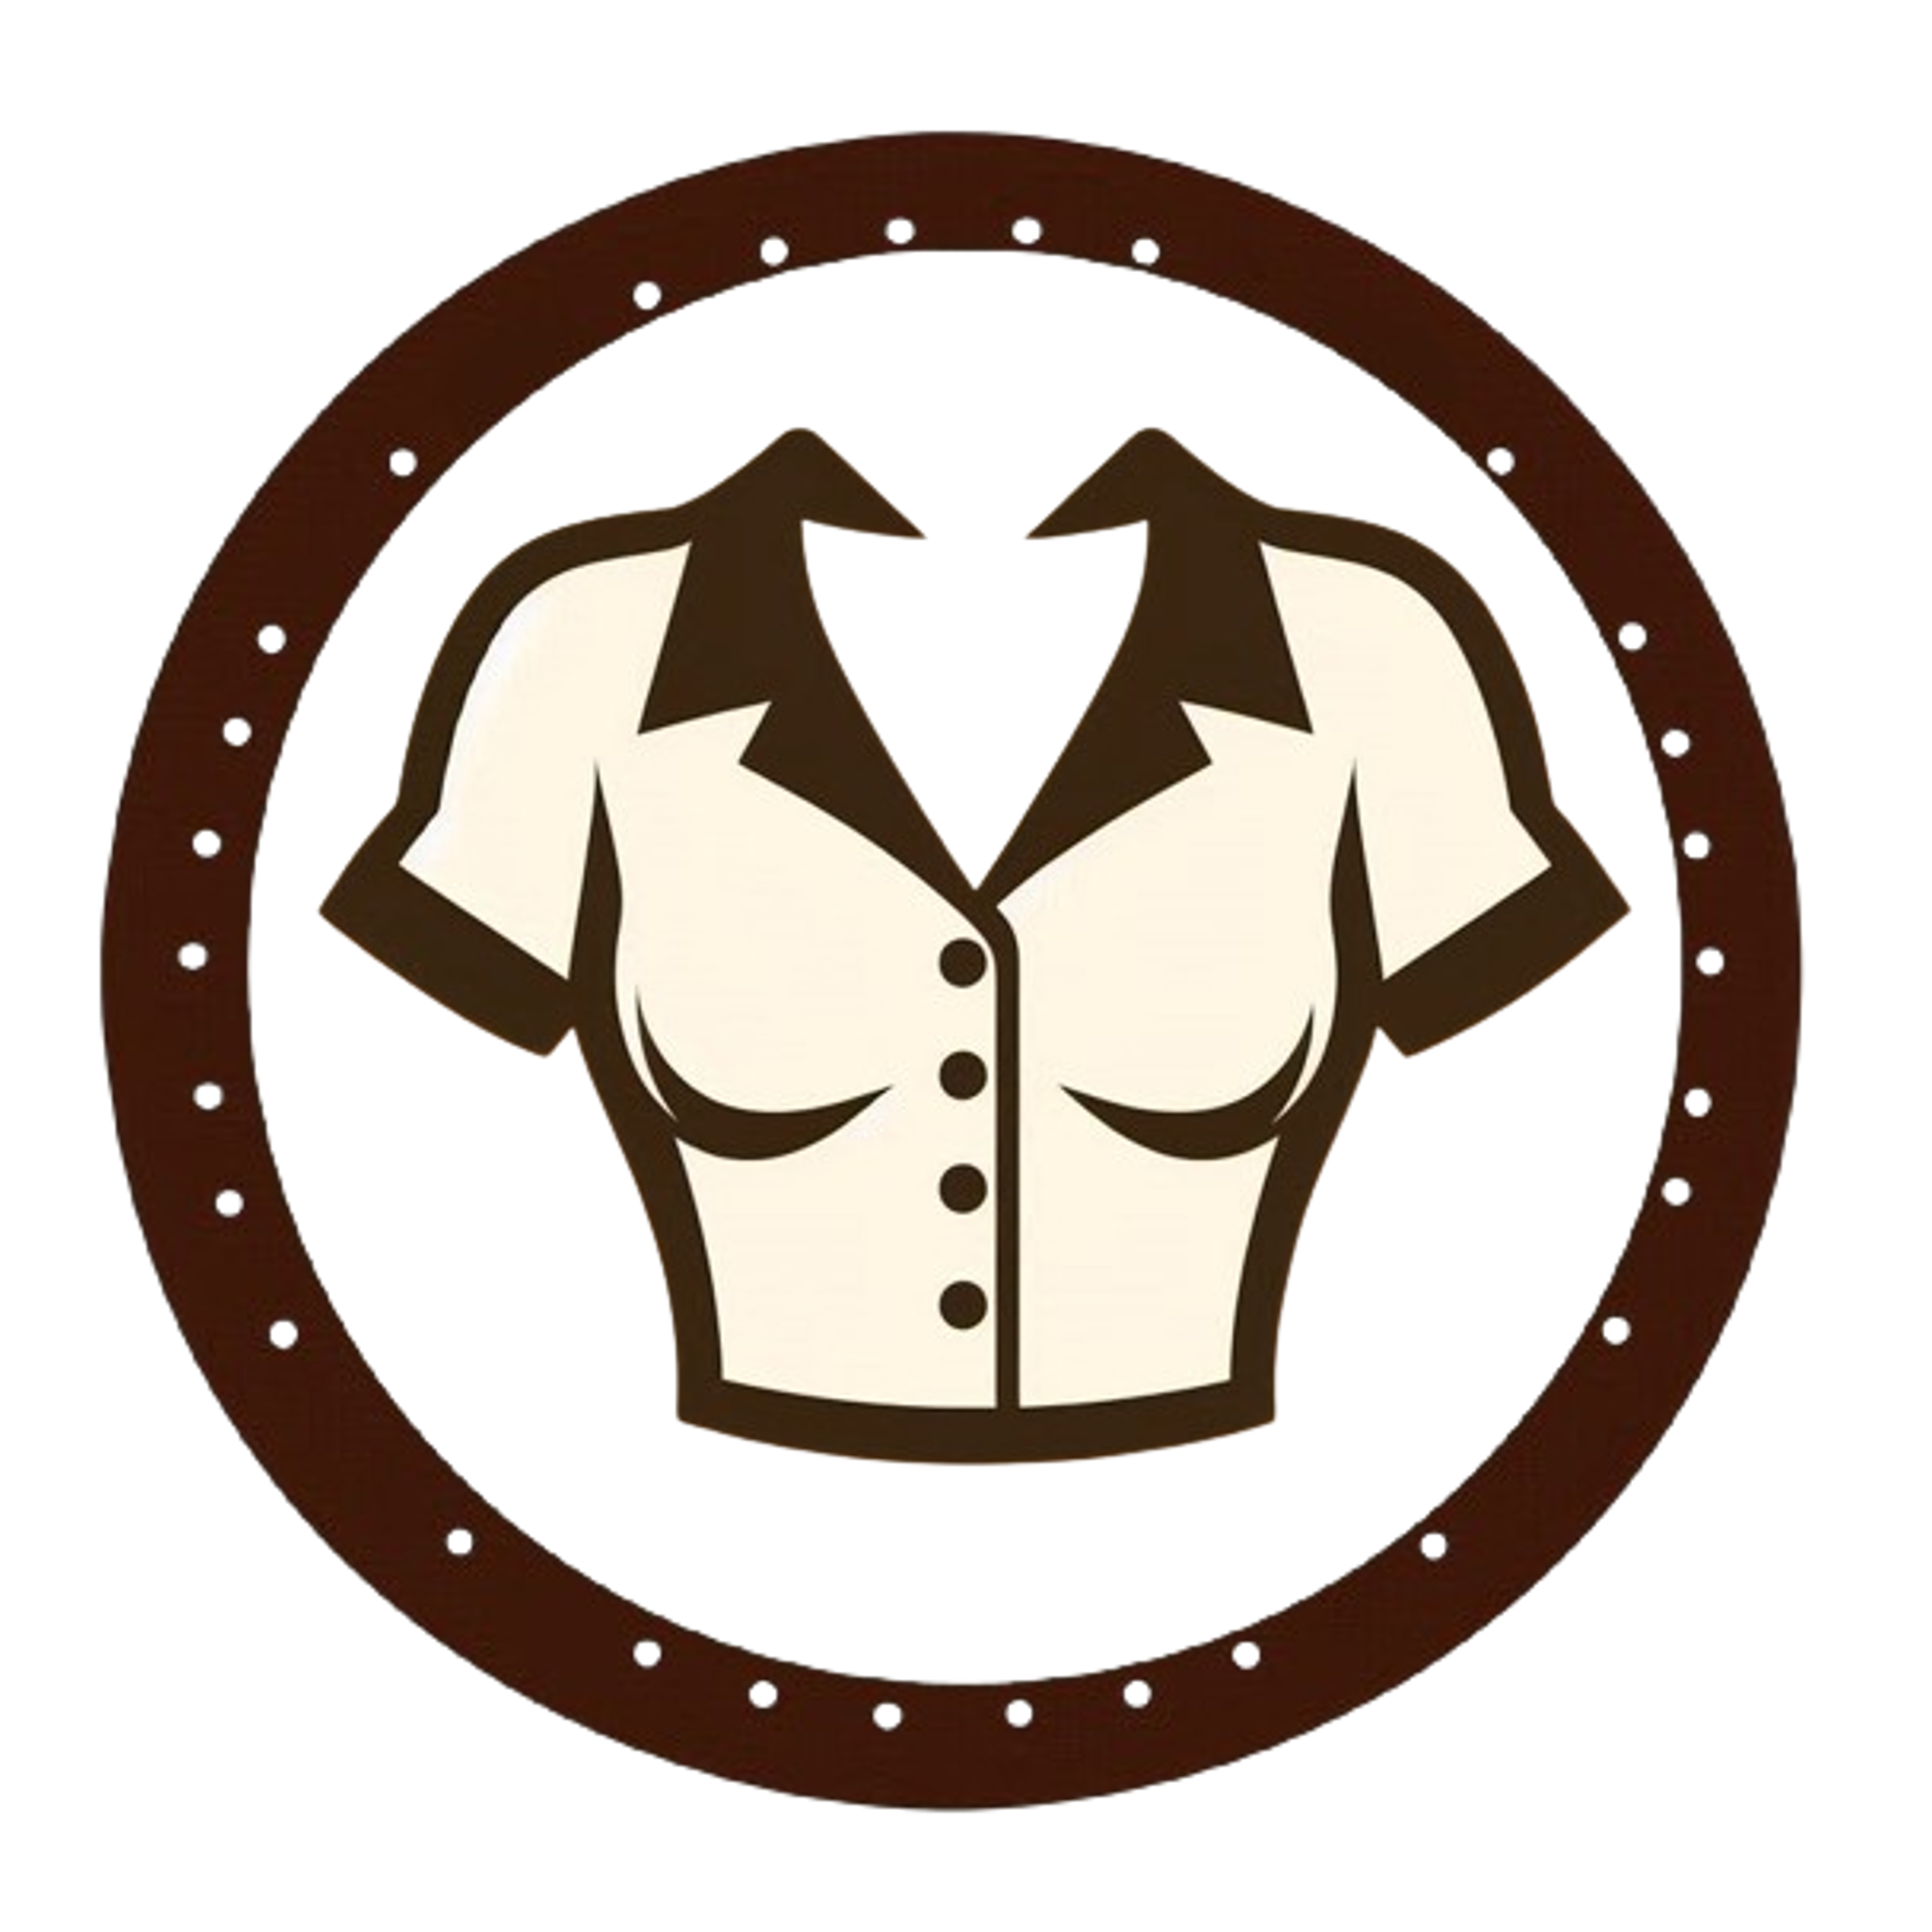



I’m looking for… some shoes for a night out
Women’s Catalogue
Featured Feeds
Most Wishlisted
Laurie
Home
Top Brands
Clothing Items
Blouses
Dresses
Wishlist & History
Great Deals
Shopping Cart
Spring Vogue
Sell your Items
80% OFF + 18 MSI
Heels
Purses
HOT SALE ALERT !
About us
© 2024 VINTAGE VOGUE
Our locations
UP TO
*Conditions apply
Skirts
Sunhats
Notes:
This is a mockup of what the final design should look like.

Slide 14
I’m looking for… some shoes for a night out
Women’s Catalogue
Featured Feeds
Blouses
Dresses
Most Wishlisted
Laurie
Home
Top Brands
Clothing Items
Wishlist & History
Great Deals
Heels
Purses
Shopping Cart
Spring Vogue
Sell your Items
80% OFF + 18 MSI
HOT SALE ALERT !
About us
© 2024 VINTAGE VOGUE
Our locations
UP TO
Skirts
Sunhats
*Conditions apply
Notes:
This is a mockup of what the final design should look like.

Slide 15
I’m looking for… some shoes for a night out
Women’s Catalogue
Featured Feeds
Blouses
Dresses
Most Wishlisted
Laurie
Home
Top Brands
Clothing Items
Wishlist & History
Great Deals
Heels
Purses
Shopping Cart
Spring Vogue
Sell your Items
80% OFF + 18 MSI
HOT SALE ALERT !
About us
© 2024 VINTAGE VOGUE
Our locations
UP TO
Skirts
Sunhats
*Conditions apply
Notes:
This is a mockup of what the final design should look like.

Slide 16
I’m looking for… some shoes for a night out
Personal Fit
Featured Feeds
Most Wishlisted
Laurie
Home
Top Brands
Clothing Items
Wishlist & History
Great Deals
Shopping Cart
Spring Vogue
Sell your Items
80% OFF + 18 MSI
HOT SALE ALERT !
About us
© 2024 VINTAGE VOGUE
Our locations
Small and elegant purse by Dasein with metal
UP TO
More…
17
*Conditions apply
Notes:
This is a mockup of what the final design should look like.

Slide 17
I’m looking for… some shoes for a night out
Personal Fit
Featured Feeds
Most Wishlisted
Laurie
Home
Top Brands
Clothing Items
Wishlist & History
Great Deals
Shopping Cart
Spring Vogue
Sell your Items
80% OFF + 18 MSI
HOT SALE ALERT !
About us
© 2024 VINTAGE VOGUE
Our locations
Small and elegant purse by Dasein with metal
UP TO
More…
17
*Conditions apply
Notes:
This is a mockup of what the final design should look like.

Slide 18
I’m looking for… some shoes for a night out
Personal Fit
Featured Feeds
Most Wishlisted
Laurie
Home
Top Brands
Clothing Items
Wishlist & History
Great Deals
Shopping Cart
Spring Vogue
Sell your Items
80% OFF + 18 MSI
HOT SALE ALERT !
About us
© 2024 VINTAGE VOGUE
Our locations
UP TO
*Conditions apply
Notes:
Click on picture to zoom in to inspect item quality.
A link for an HD image. Standard image quality for posts.

Slide 19
I’m looking for… some shoes for a night out
Personal Fit
Featured Feeds
Most Wishlisted
Laurie
Home
Top Brands
Clothing Items
Wishlist & History
Great Deals
Shopping Cart
Spring Vogue
Sell your Items
80% OFF + 18 MSI
HOT SALE ALERT !
About us
© 2024 VINTAGE VOGUE
Our locations
Small and elegant purse by Dasein with metal
UP TO
More…
17
*Conditions apply

Slide 20
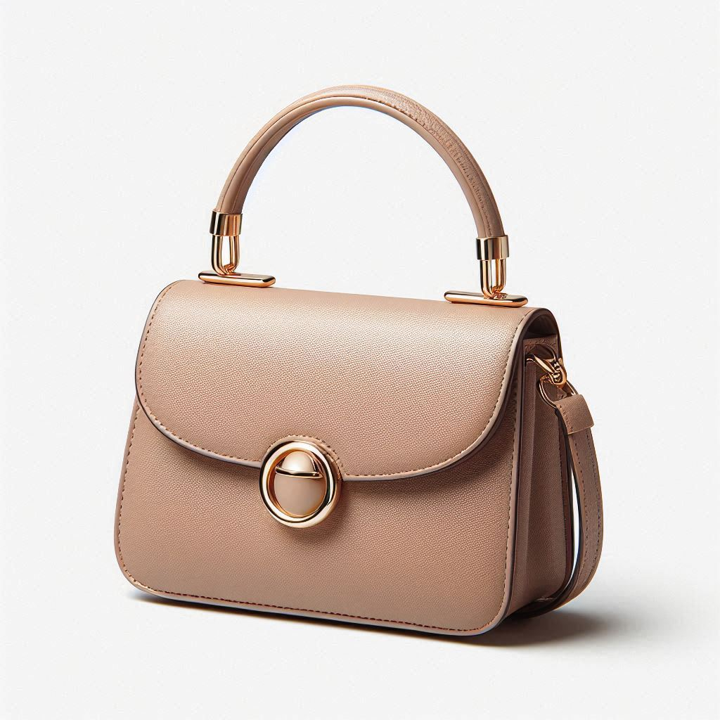
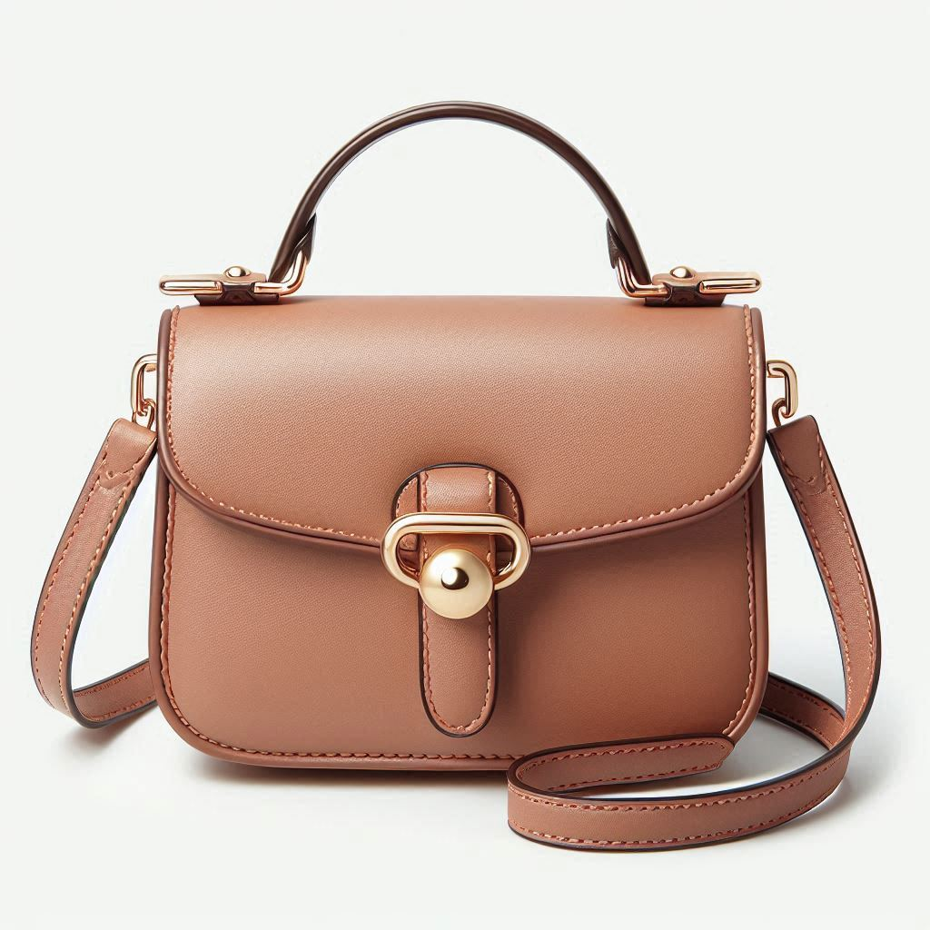
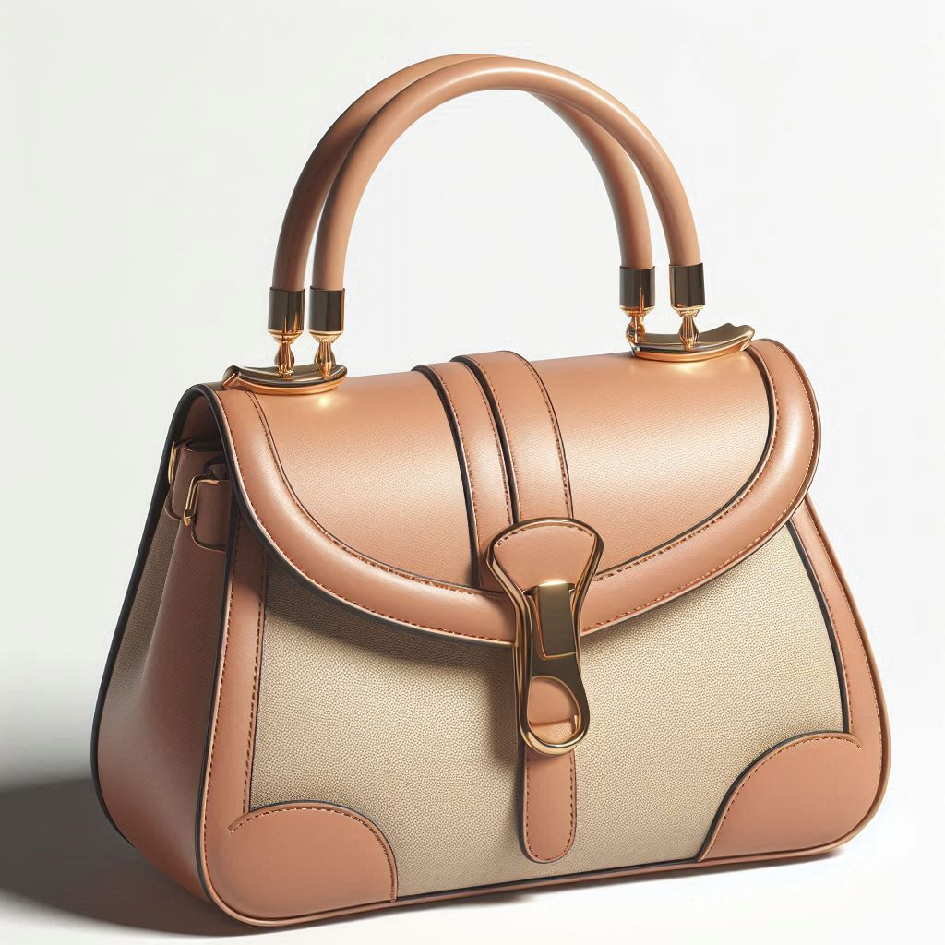
I’m looking for… some shoes for a night out
Personal Fit
Featured Feeds
Small and elegant purse by Dasein with metal clasp closure. The purse is made of a buttery soft, light brown leather with a beige colored accent panel on the front. It has a detachable gold chain strap which can be used to wear the purse as a crossbody bag or a clutch. The purse has a clean and minimalist design, making it perfect for day or evening wear.
Most Wishlisted
17
Laurie
Home
Top Brands
Clothing Items
Price: $28,000 $19,800
Wishlist & History
Great Deals
Follow
Women’s Purse
Shopping Cart
Follow
Dasein
Similar items:
Spring Vogue
Sell your Items
80% OFF + 18 MSI
HOT SALE ALERT !
About us
© 2024 VINTAGE VOGUE
Our locations
UP TO
*Conditions apply
Notes:
Original price is MSRP
Lower price is current price
User can follow/unfollow the clothing category and brand
Similar items require a frame outline

Slide 21
I’m looking for… some shoes for a night out
Personal Fit
Featured Feeds
Small and elegant purse by Dasein with metal clasp closure. The purse is made of a buttery soft, light brown leather with a beige colored accent panel on the front. It has a detachable gold chain strap which can be used to wear the purse as a crossbody bag or a clutch. The purse has a clean and minimalist design, making it perfect for day or evening wear.
Most Wishlisted
17
Laurie
Home
Top Brands
Clothing Items
Price: $28,000 $19,800
Wishlist & History
Great Deals
Follow
Women’s Purse
Shopping Cart
Follow
Dasein
Similar items:
Spring Vogue
Sell your Items
80% OFF + 18 MSI
HOT SALE ALERT !
About us
© 2024 VINTAGE VOGUE
Our locations
UP TO
*Conditions apply
Notes:
Change “shopping cart” icon color once clicked

Slide 22
I’m looking for… some shoes for a night out
Personal Fit
Featured Feeds
Small and elegant purse by Dasein with metal clasp closure. The purse is made of a buttery soft, light brown leather with a beige colored accent panel on the front. It has a detachable gold chain strap which can be used to wear the purse as a crossbody bag or a clutch. The purse has a clean and minimalist design, making it perfect for day or evening wear.
Most Wishlisted
18
Laurie
Home
Top Brands
Clothing Items
Price: $28,000 $19,800
Wishlist & History
Great Deals
Follow
Women’s Purse
Shopping Cart
Follow
Dasein
Similar items:
Spring Vogue
Sell your Items
80% OFF + 18 MSI
HOT SALE ALERT !
About us
© 2024 VINTAGE VOGUE
Our locations
UP TO
*Conditions apply
Notes:
Change “Wishlist-” icon color once clicked. Augment counter

Slide 23

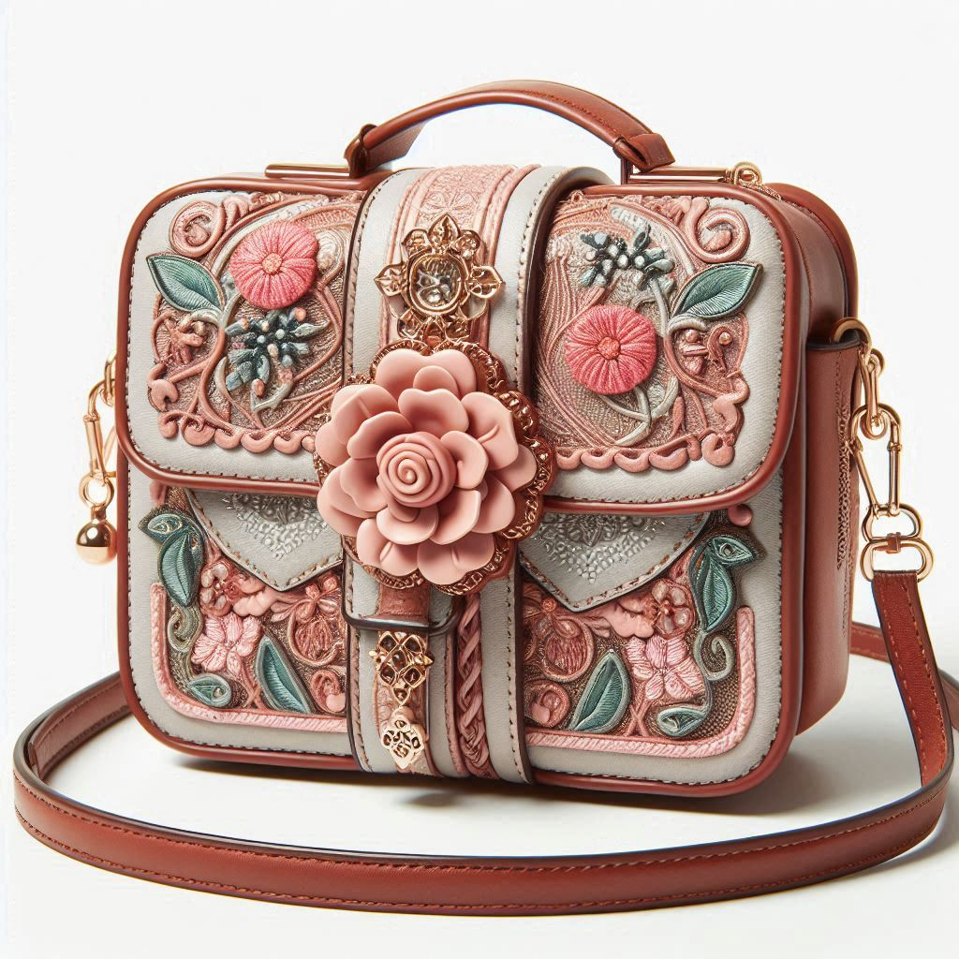

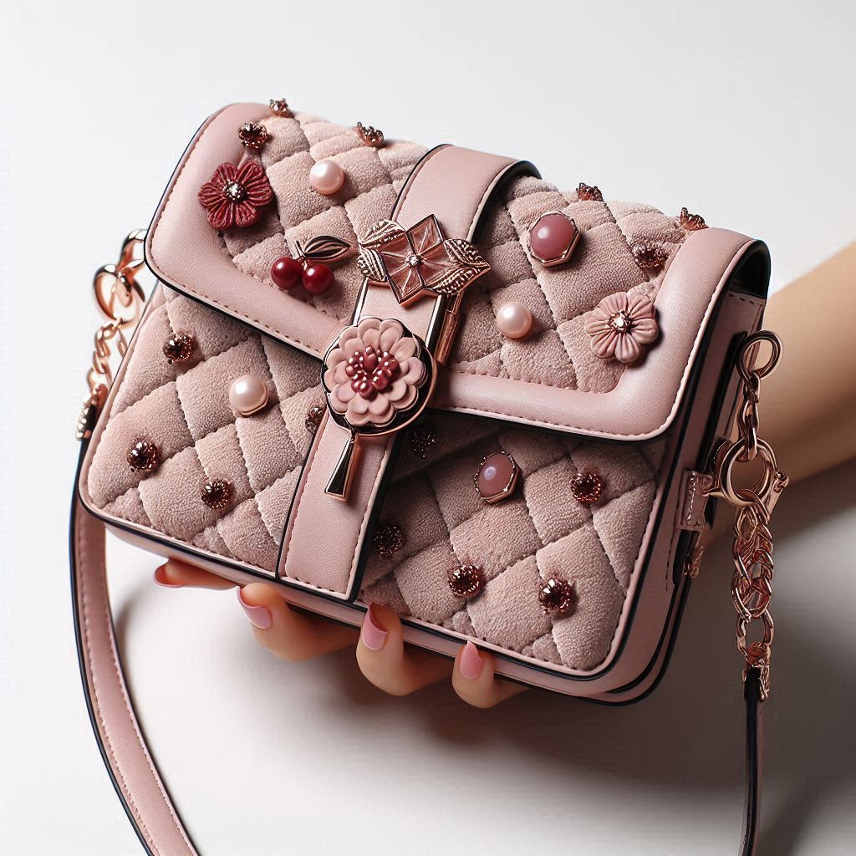
I’m looking for… some shoes for a night out
Personal Fit
Featured Feeds
Most Wishlisted
Laurie
Home
Top Brands
Clothing Items
Wishlist & History
Great Deals
Shopping Cart
Spring Vogue
Sell your Items
80% OFF + 18 MSI
HOT SALE ALERT !
About us
© 2024 VINTAGE VOGUE
Our locations
Small and elegant purse by Dasein with metal
UP TO
More…
18
*Conditions apply
Small and jovial purse by Burberry with floral
More…
42
Delicate, pink quilted purse by Louis Vuitton with
More…
42
Notes:
This is a mockup of what the final design should look like.

Slide 24
I’m looking for… some shoes for a night out
Personal Fit
Featured Feeds
Most Wishlisted
Laurie
Home
Top Brands
Clothing Items
Wishlist & History
Great Deals
Shopping Cart
Spring Vogue
Sell your Items
80% OFF + 18 MSI
HOT SALE ALERT !
About us
© 2024 VINTAGE VOGUE
Our locations
Small and elegant purse by Dasein with metal
UP TO
More…
18
*Conditions apply
Small and jovial purse by Burberry with floral
More…
42
Delicate, pink quilted purse by Louis Vuitton with
More…
42
Notes:
This is a mockup of what the final design should look like.

Slide 25
Small and elegant purse by Dasein with metal
I’m looking for… some shoes for a night out
More…
18
Personal Fit
Featured Feeds
Most Wishlisted
Laurie
Home
Top Brands
Clothing Items
Wishlist & History
Great Deals
Shopping Cart
Spring Vogue
Sell your Items
80% OFF + 18 MSI
HOT SALE ALERT !
About us
© 2024 VINTAGE VOGUE
Our locations
Small and jovial purse by Burberry with floral
UP TO
More…
42
*Conditions apply
Delicate, pink quilted purse by Louis Vuitton with
More…
42
Notes:
This is a mockup of what the final design should look like.

Slide 26
Small and elegant purse by Dasein with metal
More…
18
Small and jovial purse by Burberry with floral
I’m looking for… some shoes for a night out
More…
42
Personal Fit
Featured Feeds
Most Wishlisted
Laurie
Home
Top Brands
Clothing Items
Wishlist & History
Great Deals
Shopping Cart
Spring Vogue
Sell your Items
80% OFF + 18 MSI
HOT SALE ALERT !
About us
© 2024 VINTAGE VOGUE
Our locations
Delicate, pink quilted purse by Louis Vuitton with
UP TO
More…
42
*Conditions apply
Notes:
This is a mockup of what the final design should look like.

Slide 27
Small and elegant purse by Dasein with metal
More…
18
Small and jovial purse by Burberry with floral
I’m looking for… some shoes for a night out
More…
42
Personal Fit
Featured Feeds
Most Wishlisted
Laurie
Home
Top Brands
Clothing Items
Wishlist & History
Great Deals
Shopping Cart
Spring Vogue
Sell your Items
80% OFF + 18 MSI
HOT SALE ALERT !
About us
© 2024 VINTAGE VOGUE
Our locations
Delicate, pink quilted purse by Louis Vuitton with
UP TO
More…
43
*Conditions apply
Notes:
This is a mockup of what the final design should look like.

Slide 28
Small and elegant purse by Dasein with metal
More…
18
Small and jovial purse by Burberry with floral
I’m looking for… some shoes for a night out
More…
42
Personal Fit
Featured Feeds
Most Wishlisted
Laurie
Home
Top Brands
Clothing Items
Wishlist & History
Great Deals
Shopping Cart
Spring Vogue
Sell your Items
80% OFF + 18 MSI
HOT SALE ALERT !
About us
© 2024 VINTAGE VOGUE
Our locations
Delicate, pink quilted purse by Louis Vuitton with
UP TO
More…
43
*Conditions apply
Notes:
This is a mockup of what the final design should look like.

Slide 29
Small and elegant purse by Dasein with metal
More…
18
Small and jovial purse by Burberry with floral
I’m looking for… some shoes for a night out
More…
42
Personal Fit
Featured Feeds
Most Wishlisted
Laurie
Home
Top Brands
Clothing Items
Wishlist & History
Wishlist
Great Deals
History
Shopping Cart
Spring Vogue
Sell your Items
80% OFF + 18 MSI
HOT SALE ALERT !
About us
© 2024 VINTAGE VOGUE
Our locations
Delicate, pink quilted purse by Louis Vuitton with
UP TO
More…
43
*Conditions apply
Notes:
This is a mockup of what the final design should look like.

Slide 30
Small and elegant purse by Dasein with metal
More…
18
Small and jovial purse by Burberry with floral
I’m looking for… some shoes for a night out
More…
42
Personal Fit
Featured Feeds
Most Wishlisted
Laurie
Home
Top Brands
Clothing Items
Wishlist & History
Wishlist
Great Deals
History
Shopping Cart
Spring Vogue
Sell your Items
80% OFF + 18 MSI
HOT SALE ALERT !
About us
© 2024 VINTAGE VOGUE
Our locations
Delicate, pink quilted purse by Louis Vuitton with
UP TO
More…
43
*Conditions apply
Notes:
In the “Wishlist & History” tab, the user will have the option to see either.

Slide 31
I’m looking for… some shoes for a night out
Personal Fit
Featured Feeds
Most Wishlisted
Laurie
Home
Top Brands
Clothing Items
Wishlist & History
Great Deals
Shopping Cart
Spring Vogue
Sell your Items
80% OFF + 18 MSI
HOT SALE ALERT !
About us
© 2024 VINTAGE VOGUE
Our locations
Small and elegant purse by Dasein with metal
UP TO
More…
18
*Conditions apply
Delicate, pink quilted purse by Louis Vuitton with
More…
43
Notes:
In the wishlist section, the user can see all the items they have Wishlisted so far…

Slide 32
I’m looking for… some shoes for a night out
Small and elegant purse by Dasein with metal
More…
Personal Fit
18
Featured Feeds
Most Wishlisted
Laurie
Home
Top Brands
Clothing Items
Wishlist & History
Great Deals
Shopping Cart
Spring Vogue
Sell your Items
80% OFF + 18 MSI
HOT SALE ALERT !
About us
© 2024 VINTAGE VOGUE
Our locations
Delicate, pink quilted purse by Louis Vuitton with
UP TO
More…
*Conditions apply
43
Notes:
…and that still are available.

Slide 33
I’m looking for… some shoes for a night out
Small and elegant purse by Dasein with metal
More…
Personal Fit
18
Featured Feeds
Most Wishlisted
Laurie
Home
Top Brands
Clothing Items
Wishlist & History
Great Deals
Shopping Cart
Spring Vogue
Sell your Items
80% OFF + 18 MSI
HOT SALE ALERT !
About us
© 2024 VINTAGE VOGUE
Our locations
Delicate, pink quilted purse by Louis Vuitton with
UP TO
More…
*Conditions apply
43
Notes:
For the case when an item in the wishlist is sold. The item first will disappear from their wishlist feed.

Slide 34

I’m looking for… some shoes for a night out
Personal Fit
Featured Feeds
Oops! 1 item(s) in your wishlist has(have) already been sold!
Most Wishlisted
Laurie
Home
Top Brands
Clothing Items
Wishlist & History
Great Deals
Shopping Cart
Spring Vogue
Sell your Items
80% OFF + 18 MSI
HOT SALE ALERT !
About us
© 2024 VINTAGE VOGUE
Our locations
Small and elegant purse by Dasein with metal
UP TO
More…
18
*Conditions apply
Notes:
Then, a notification shall appear notifying the user that their item is already sold and no longer in stock.
I find it preferable not to show which items were sold. It gives a feeling of a missed opportunity.

Slide 35
I’m looking for… some shoes for a night out
Personal Fit
Featured Feeds
Oops! 1 item(s) in your wishlist has(have) already been sold!
Most Wishlisted
Laurie
Home
Top Brands
Clothing Items
Wishlist & History
Great Deals
Shopping Cart
Spring Vogue
Sell your Items
80% OFF + 18 MSI
HOT SALE ALERT !
About us
© 2024 VINTAGE VOGUE
Our locations
Small and elegant purse by Dasein with metal
UP TO
More…
18
*Conditions apply
Notes:
The user may then delete this notification.

Slide 36
I’m looking for… some shoes for a night out
Personal Fit
Featured Feeds
Most Wishlisted
Laurie
Home
Top Brands
Clothing Items
Wishlist & History
Great Deals
Shopping Cart
Spring Vogue
Sell your Items
80% OFF + 18 MSI
HOT SALE ALERT !
About us
© 2024 VINTAGE VOGUE
Our locations
Small and elegant purse by Dasein with metal
UP TO
More…
18
*Conditions apply
Notes:
Now...

Slide 37
I’m looking for… some shoes for a night out
Personal Fit
Featured Feeds
Most Wishlisted
Laurie
Home
Top Brands
Clothing Items
Wishlist & History
Wishlist
Great Deals
History
Shopping Cart
Spring Vogue
Sell your Items
80% OFF + 18 MSI
HOT SALE ALERT !
About us
© 2024 VINTAGE VOGUE
Our locations
Small and elegant purse by Dasein with metal
UP TO
More…
18
*Conditions apply
Notes:
Looking at the history of seen items…

Slide 38
I’m looking for… some shoes for a night out
Personal Fit
Featured Feeds
Most Wishlisted
Laurie
Home
Top Brands
Clothing Items
Wishlist & History
Great Deals
Shopping Cart
Spring Vogue
Sell your Items
80% OFF + 18 MSI
HOT SALE ALERT !
About us
© 2024 VINTAGE VOGUE
Our locations
UP TO
*Conditions apply
Notes:
The display for every item that has been seen, not necessarily browsed, is in a format grid and are always sorted starting from most recently seen.
It is updated every time the user re-enters their history feed. Clicking

Slide 39
I’m looking for… some shoes for a night out
Personal Fit
Featured Feeds
Most Wishlisted
Laurie
Home
Top Brands
Clothing Items
Wishlist & History
Great Deals
Shopping Cart
Spring Vogue
Sell your Items
80% OFF + 18 MSI
HOT SALE ALERT !
About us
© 2024 VINTAGE VOGUE
Our locations
UP TO
*Conditions apply
Notes:
By clicking on any item…

Slide 40
Small and elegant purse by Dasein with metal
I’m looking for… some shoes for a night out
More…
18
Personal Fit
Featured Feeds
Most Wishlisted
Laurie
Home
Top Brands
Clothing Items
Wishlist & History
Great Deals
Shopping Cart
Spring Vogue
Sell your Items
80% OFF + 18 MSI
HOT SALE ALERT !
About us
© 2024 VINTAGE VOGUE
Our locations
Small and jovial purse by Burberry with floral
UP TO
More…
42
*Conditions apply
White floral dress by Zara with decorative bl
More…
71
White floral dress by Zara with decorative bl
More…
50
Notes:
A new mini-feed will appear to scroll

Slide 41
Small and elegant purse by Dasein with metal
More…
18
Small and jovial purse by Burberry with floral
More…
42
White floral dress by Zara with decorative bl
I’m looking for… some shoes for a night out
More…
71
Personal Fit
Featured Feeds
Most Wishlisted
Laurie
Home
Top Brands
Clothing Items
Wishlist & History
Great Deals
Shopping Cart
Spring Vogue
Sell your Items
80% OFF + 18 MSI
HOT SALE ALERT !
About us
© 2024 VINTAGE VOGUE
Our locations
White floral dress by Zara with decorative bl
UP TO
More…
50
*Conditions apply
Notes:
A new mini-feed will appear to scroll through all the items the user has seen.

Slide 42
I’m looking for… some shoes for a night out
Personal Fit
Featured Feeds
Most Wishlisted
Laurie
Home
Top Brands
Clothing Items
Wishlist & History
Great Deals
Shopping Cart
Spring Vogue
Sell your Items
80% OFF + 18 MSI
HOT SALE ALERT !
About us
© 2024 VINTAGE VOGUE
Our locations
Small and elegant purse by Dasein with metal
UP TO
More…
18
*Conditions apply
Small and jovial purse by Burberry with floral
More…
42
White floral dress by Zara with decorative bl
More…
71
White floral dress by Zara with decorative bl
More…
50

Slide 43
I’m looking for… some shoes for a night out
Personal Fit
Featured Feeds
Most Wishlisted
Laurie
Home
Top Brands
Clothing Items
Wishlist & History
Great Deals
Shopping Cart
Spring Vogue
Sell your Items
80% OFF + 18 MSI
HOT SALE ALERT !
About us
© 2024 VINTAGE VOGUE
Our locations
Small and elegant purse by Dasein with metal
UP TO
More…
18
*Conditions apply
Small and jovial purse by Burberry with floral
More…
42
White floral dress by Zara with decorative bl
More…
71
White floral dress by Zara with decorative bl
More…
50

Slide 44
I’m looking for… some shoes for a night out
Personal Fit
Featured Feeds
Most Wishlisted
Laurie
Home
Top Brands
Clothing Items
Wishlist & History
Great Deals
Shopping Cart
Sh. Cart
Purchased
Spring Vogue
Sell your Items
80% OFF + 18 MSI
HOT SALE ALERT !
About us
© 2024 VINTAGE VOGUE
Our locations
Small and elegant purse by Dasein with metal
UP TO
More…
18
*Conditions apply
Small and jovial purse by Burberry with floral
More…
42
White floral dress by Zara with decorative bl
More…
71
White floral dress by Zara with decorative bl
More…
50

Slide 45
I’m looking for… some shoes for a night out
Personal Fit
Featured Feeds
Most Wishlisted
Laurie
Home
Top Brands
Clothing Items
Wishlist & History
Great Deals
Shopping Cart
Spring Vogue
Sell your Items
80% OFF + 18 MSI
HOT SALE ALERT !
About us
© 2024 VINTAGE VOGUE
Our locations
UP TO
*Conditions apply

Slide 46
User queries

Slide 47
User queries ideas
What [items] do you have that are less than 5000?
I am looking for an outfit to use on the beach. -> Summer?
I’m looking for shoes for a night event.
I have an elegant dinner and want a complete new look.
Red dresses in my wishlist.
A dress with a flower pattern for Spring
I am looking for a Porsche
Default message when a search is unsuccessful.
→ Oops! Seems we don’t have that item. Modify your query and Try again!

Slide 48
System Design

Slide 50
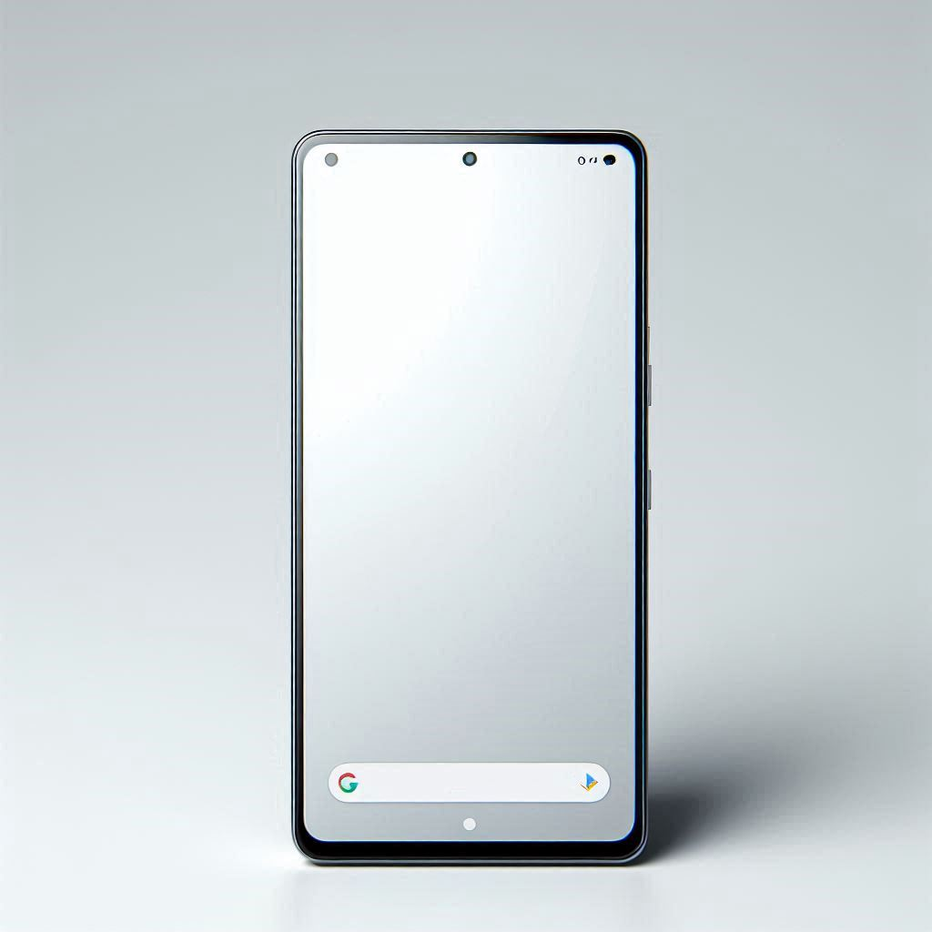



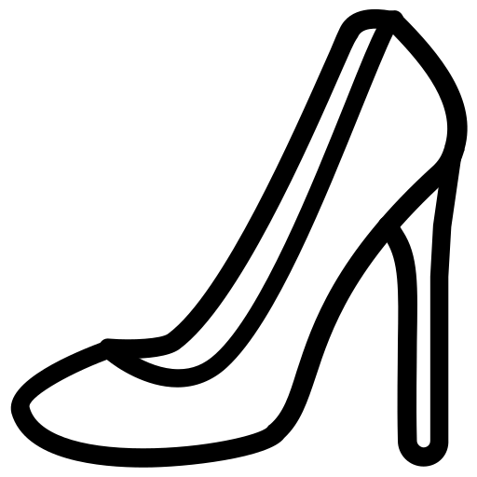

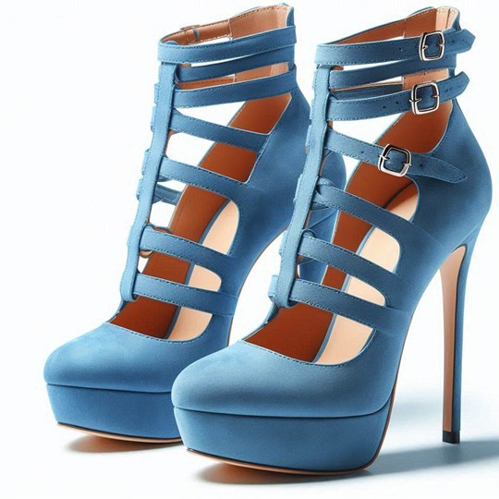


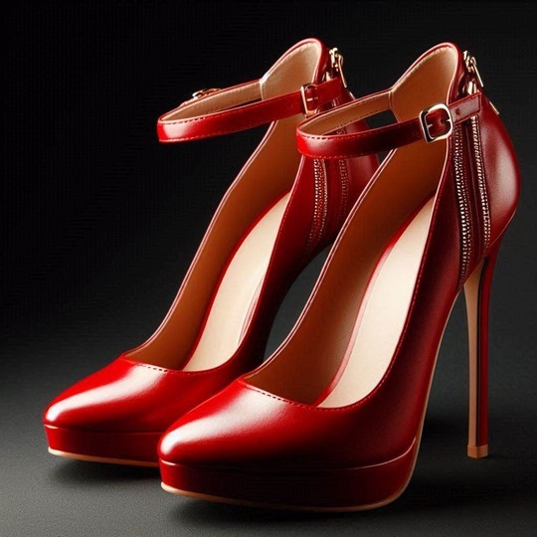
Categories
Most wanted
Closets
Designers
Less than $5k
Hi, Laurie!
I’m looking for some shoes for a night out
Your Feeds
Categories
Shopping Cart
Sell your items
Our locations
Blue high heel shoes by Kurt Geiger made with
More…
127
57
80% OFF + 18 MSI
HOT SALE ALERT !
UP TO
*Conditions apply
Red high heel shoes by Yves Saint Laurent with
More…
381
80

Slide 52
Deployment
Update data from every microservice to the client’s data
Shadow Deployment: Test out the prototype with dummy data and see that it behaves as expected. Human tests.
Canary Deployment: Start with a small fraction of traffic.
Blue/Green Deployment: Route customer traffic from old website to new website. Rollback is easy to do. Alternatively, have them both running in parallel but with different domains.

Slide 53
Automation
Most microservices can be fully automated, but there are others that may benefit from human intervention.
“Sell your items” microservice may take feedback from the user when the item’s metadata is generated. Having a human in the loop would turn this into partial automation.

Slide 54
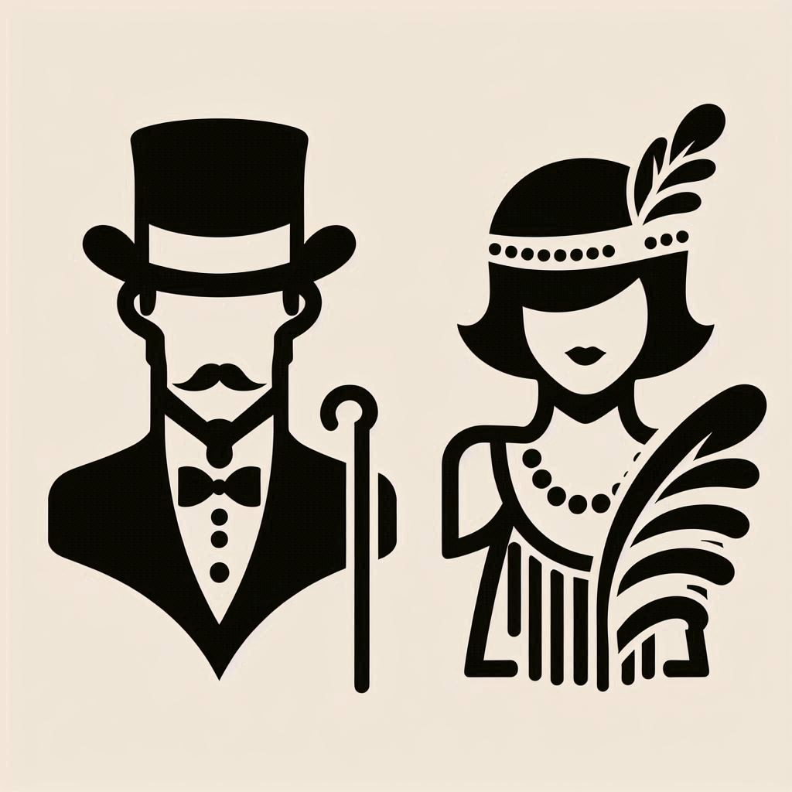

Slide 55

THE

Slide 56
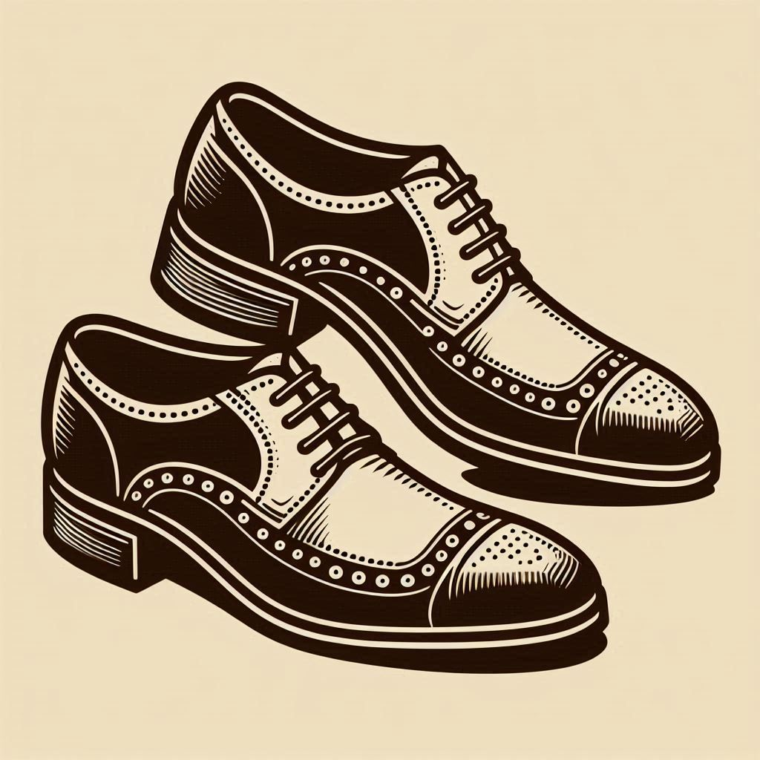
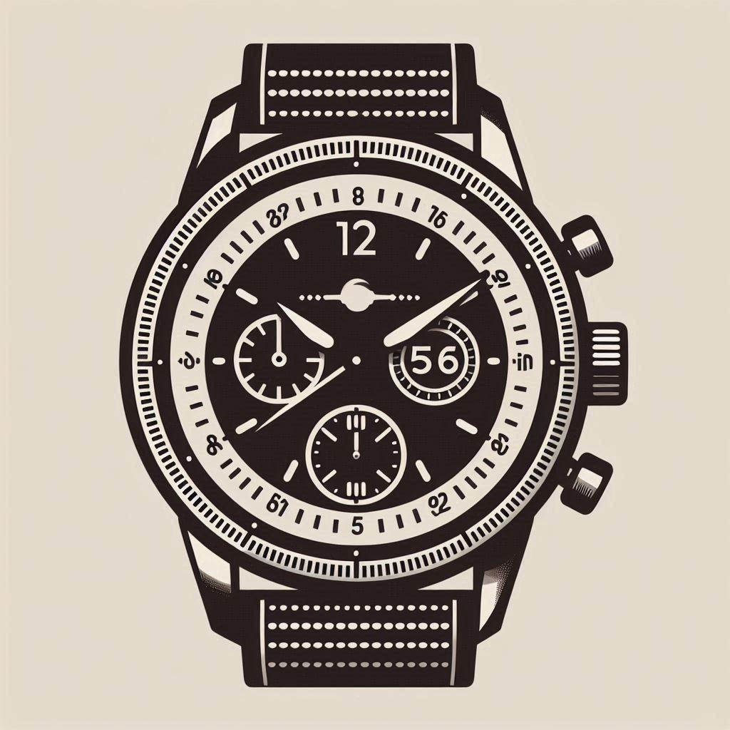


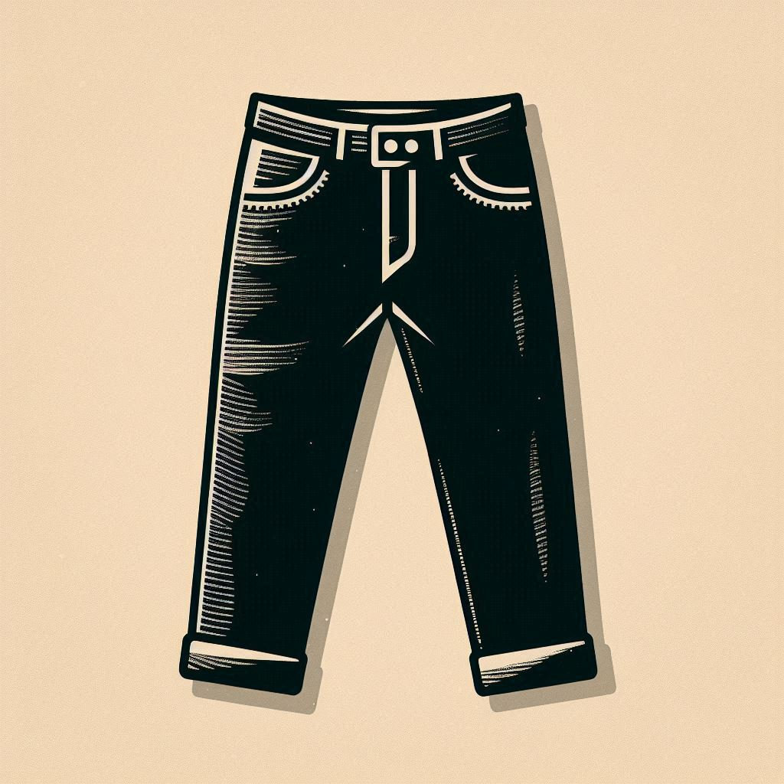


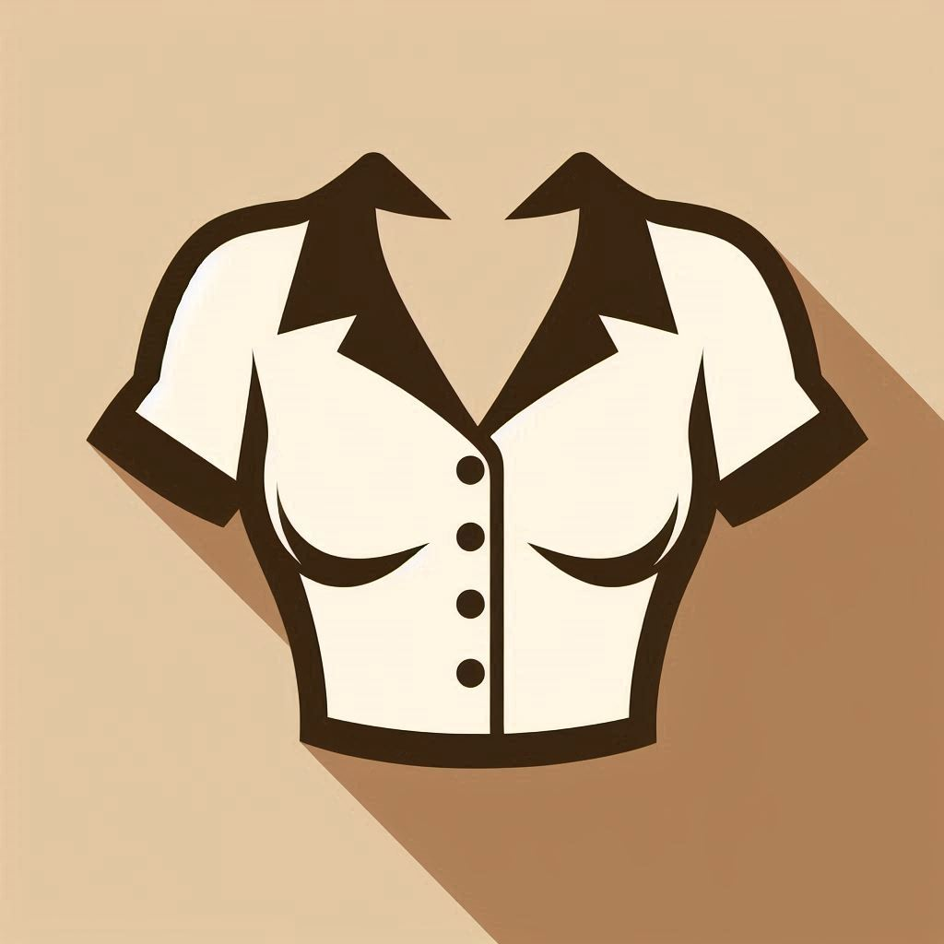
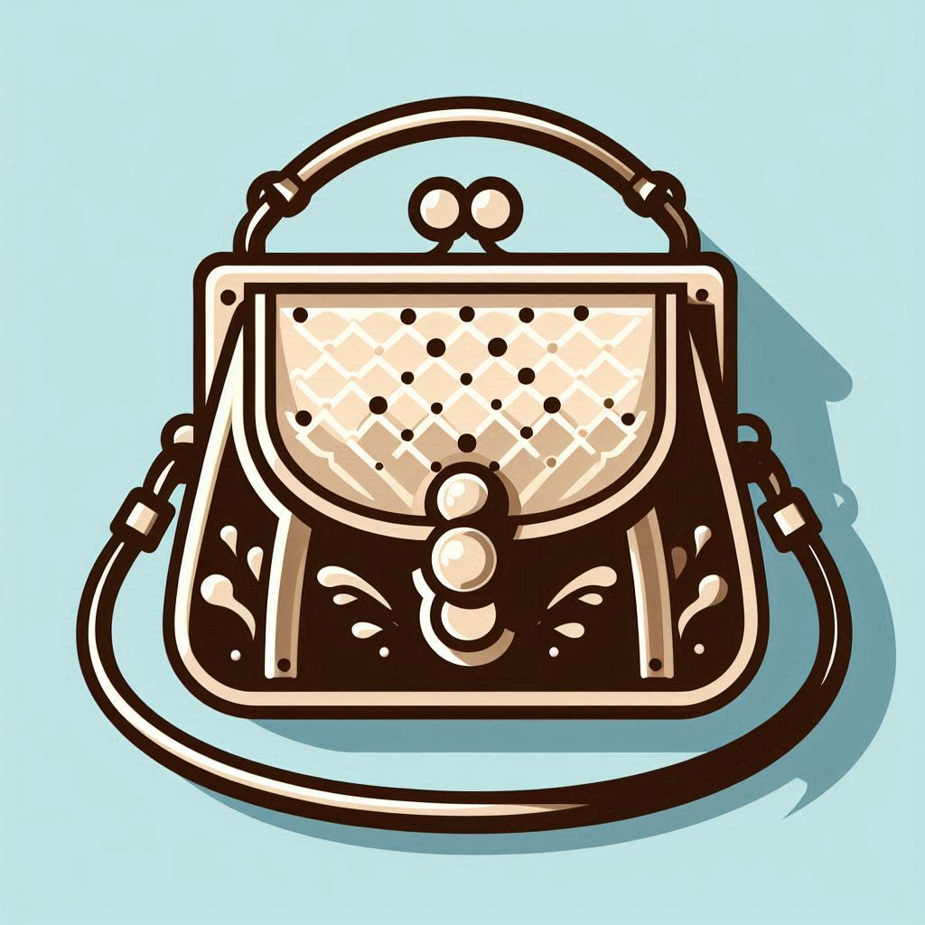
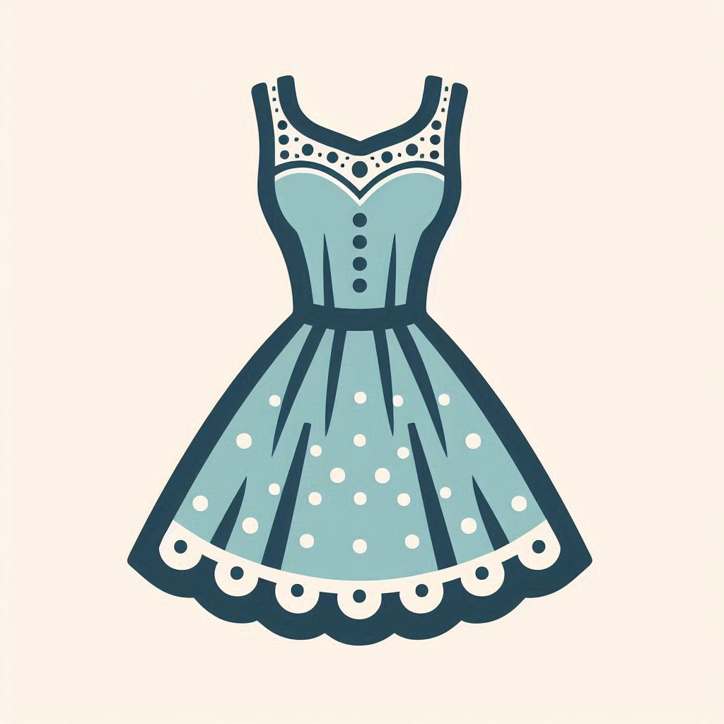
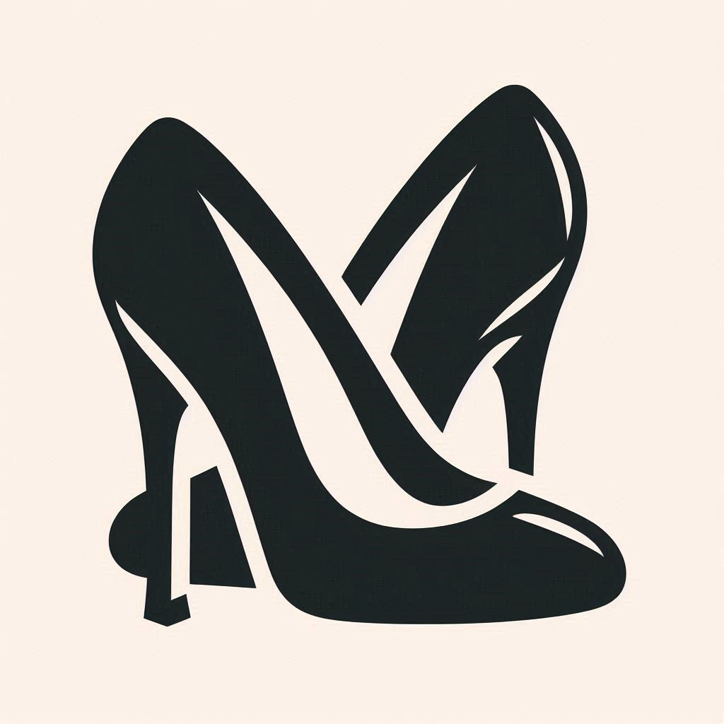
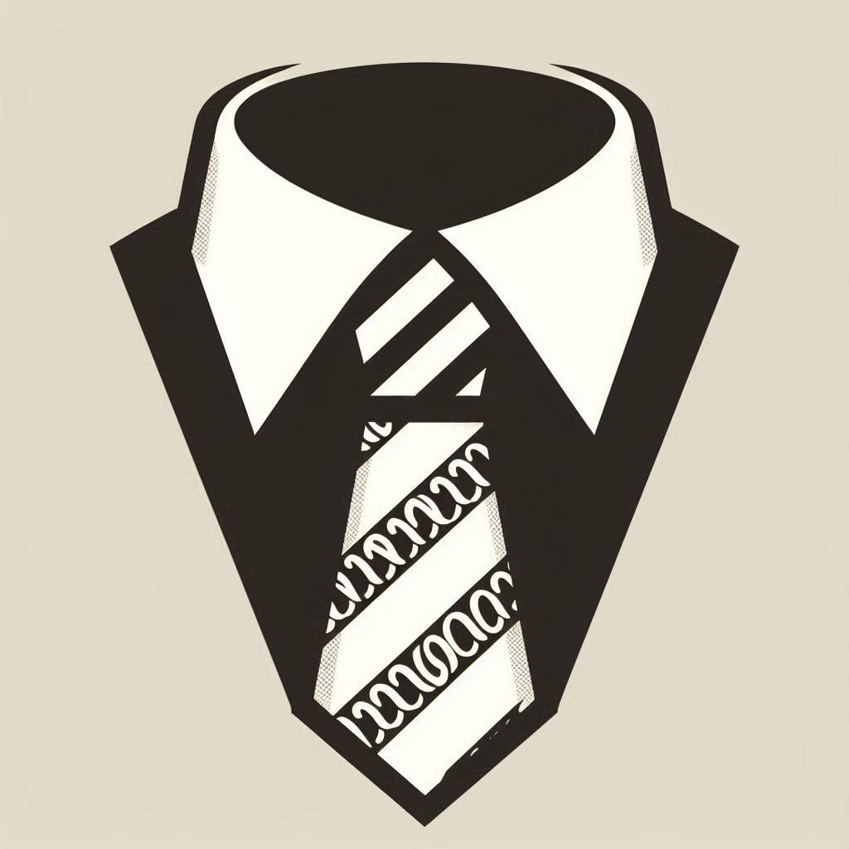

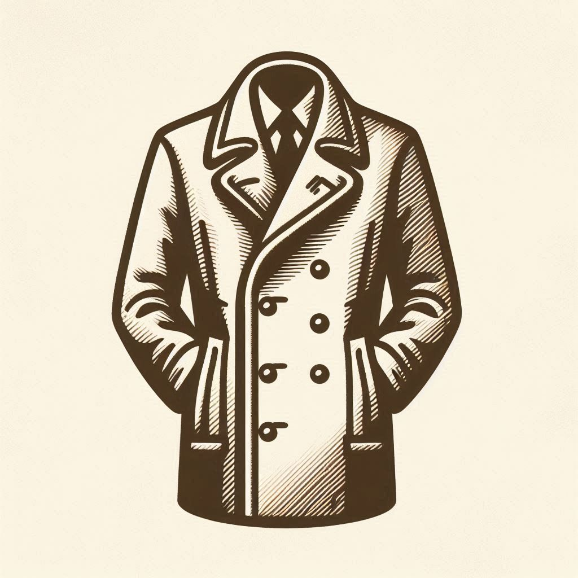


Slide 57


Slide 58



Slide 59
Ideas
Train an LLM to recognize Brands / Product Sizes?
Use automated Google Search to find brand icons and text logos
Use Gemini LLM to obtain information from clothing items.

Slide 60
Thank you!

